Slide 1

VIDEO RESUME
-BY MRIDHU RAJPUT

Slide 2

Digital Resume / Video Resume
PURPOSE: TO BREAK THE MONOTONY OF SAME OLD THING
MUST HAVE’S:
A simple introduction.
What others think about you?
What you’re currently doing?
What you have accomplished in the past?
Where do you wish to head towards in the future?
Be mindful.

Slide 3
Digital Resume / Video Resume
7. Know your whys and wherefores.
8. Resonate with the people around you.
9. Focus on what’s relevant.
10. Prepare in advance.
11. Highlight your SELLING POINTS
12. Have a short, crisp impactful introduction.
13. Prepare SWOT.
14. The key is CONFIDENCE
15. Be Yourself and SMILE

Slide 4
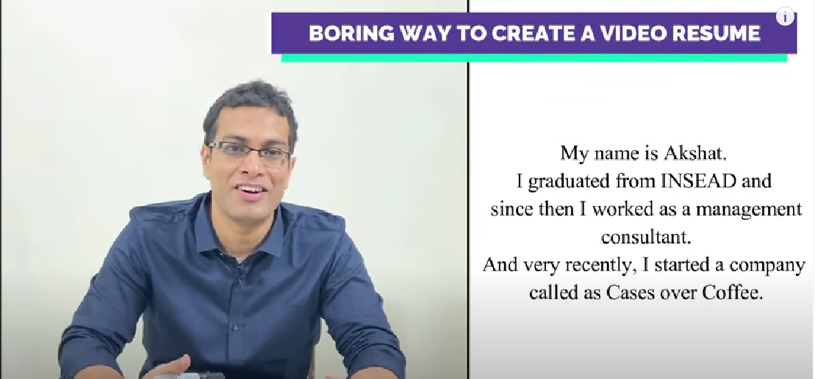
BORING: Full of facts!
.
A very mundane way of doing it.
All of your competitors will be doing so.

Slide 5
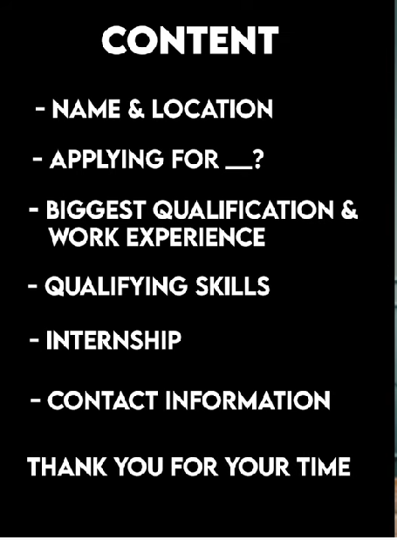
GOOD WAY TO WRITE A RESUME
Useful Information
Specify Story
Align to the Job

Slide 6

EXAMPLE

Slide 7
AESHETICS TO CREATE A GOOD VIDEO RESUME
Sufficient Light
Good Mic/Earphones
Plain Background

Slide 8
Tips for Creating A Video Resume
Step 1:Make a note of what you say:
Add as many interesting details to your video resume.
You can also add interesting anecdotes that are very specific to the job role you are applying for.
Collate these notes and know what you want to exactly communicate through your video resume, you can move on to scripting it.
Step 2: Write your video resume script
Your video resume script is the blueprint of the actual video.
Writing a script for your video resume is the easiest way to put it in an audio-visual format.
Step 3: Shooting the visuals and recording the audio:
Start with speaking into the camera.
Set up the frame in a well-lit area with a clean background that is not too distracting - like a plain wall or your desk.

Slide 9
Tips for Creating A Video Resume
Step 4: Additional Visuals:
Time to start working on supporting footages or B-rolls.
These can be images and videos that support your narrative.
You must have enough B rolls to make your video resume visually engaging.
Use B rolls to cover any remaining cuts to ensure that your video flows smoothly.
Step 5: Final check before exporting
Preview the video by clicking on the play icon above the timeline. If you’re happy with what you see, click on Export and then Download your video resume once it is ready.
**Min Duration of the video= 90 seconds.

Slide 10
Video Resume Do’s
Be professional
Find a good background.
Prepare a script.
Know your audience.
Show, don’t tell
Keep it brief.
Share with friends & Family.
** Always keep in mind that once your video is on the internet, you no longer have control over who sees it or how it's shared. Take feedback from friends and family seriously. If they think it's a misfire, do not send the video to potential employers.

Slide 11
https://www.youtube.com/watch?v=d-pHWe1S-KQ

